Slide 1
Adventure Awaits
2025-2026
Dr. Gilbert L. Porter Elementary School

Slide 2



Connect with us on the web…
https://www.drglpelementary.org/
@gilbertporteres
@gilbertporteres
@gilbertporteres

Slide 3
FAST Testing
FAST PM2
    Reading Monday, January 12, 2026
    Mathematics Tuesday, January 13, 2026
FAST PM3
    Reading Tuesday, May 12, 2026
    Mathematics Thursday, May 14, 2026
    Science Tuesday, May 15 2026
Must complete test in order to participate in field trip or activity.

Slide 4
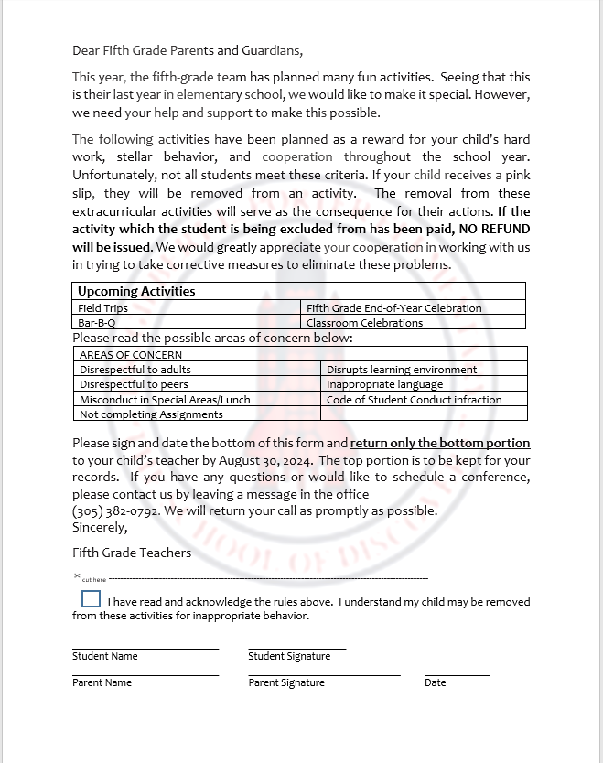
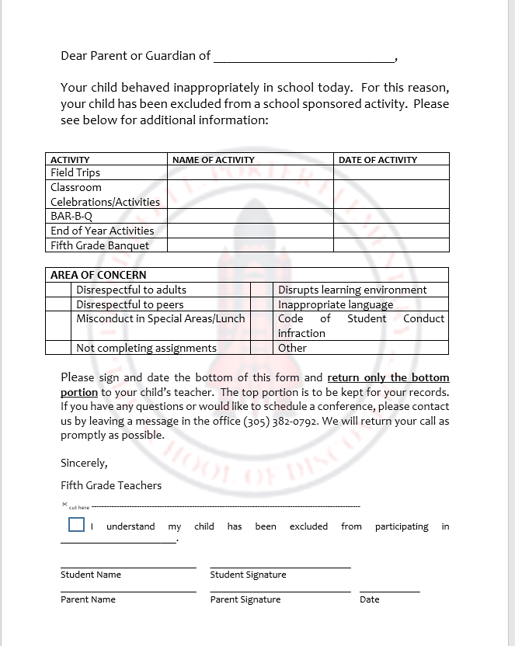
STUDENT CONTRACT

Slide 5


FIFTH GRADE EVENTS
Field Trips-throughout the year
Adrienne Arsht Center – October 13, 2025
Royal Palm Everglades - December 5th or December 8, 2025
Actor’s Playhouse - December 11, 2025
Bowling – March 2026
Urban Air - May 29, 2026
Banquet-May 20, 2026
Promotion Ceremony-May 26, 2026
Fun Day-June 2, 2026

Slide 6
VOLUNTEERS NEEDED
All parents wishing to volunteer MUST be a cleared volunteer (Parent Resource Tab)
Must provide volunteer number to teacher prior to event.
Different volunteers will be randomly chosen
Field Trips
Fundraising events
End of the year video
Fun Day
Banquet
class gift
setting Up (Decorations)
Please see Ms. Ingrid Garcia for sign up.

Slide 7
CLASS T-SHIRTS
T-Shirts were designed by our art teacher, Ms. Sanchez.
The price is $15 per shirt.
Second order due by Friday, September 27, 2025
They will be required for all field trips and fifth grade activities for all students and parents.

Slide 8


FIFTH GRADE BANQUET
* Fifth Grade Banquet will be held on Wednesday,
May 20, 2026, from 10am-1pm.
* It will be a field trip and it’s for students ONLY.
Student will leave from the school. No drop-off at the
banquet hall.
* The banquet will be at 305 Club located at 8770 SW 131st
Street
* Price per student will be $75 or less, price is dependent on
funds raised throughout the year.
* If there are any outstanding books or unpaid fines, students
will not be able to attend.

Slide 9
BANQUET ATTIRE
* Girls
No spaghetti straps or strapless dresses
Knee Length dresses
No tight dresses
No high heels
* Boys
Sports jackets or suits not necessary
Pants-No jeans or shorts
Dress or polo shirts
Dress shoes or sneakers

Slide 10
FUNDRAISERS
McTeacher Night at McDonalds
Texas Roadhouse Night
Fuddrucker Night
Panera Night
Shaved Ice
Holiday Candy Grams
Spring Grams
Valentine’s Day/Mother’s Day Wooden Roses
Help us support and bring down the price of the banquet.

Slide 11
MAGNET FAIR
Arvida Middle
Hammocks Middle
Herbert A. Ammons Middle
Howard D. McMillan Middle
Jorge Mas Canosa Middle
Miami Arts Studio@ Zelda Glazer

Slide 12
Thank you!

