Slide 1



OPEN HOUSE
Dr. Gilbert L. Porter Elementary
2025-2026

Slide 2
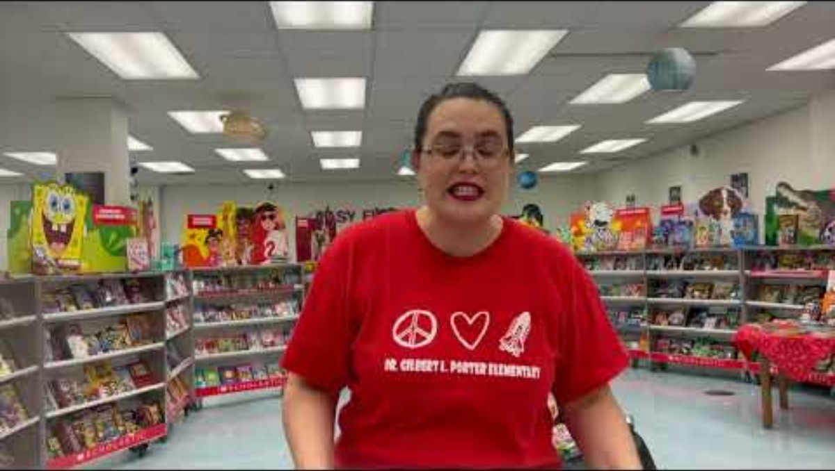
Welcome Message

Slide 3
Superintendent’s Message
English Message

Slide 4

Our Mission
Dr. Gilbert L. Porter Elementary School envisions every child to be a lifelong learner who is a responsible, productive, and caring citizen. It is our mission to create an environment that focuses on the child's strengths, to motivate parents, teachers, administrators, and non-instructional personnel to believe that in "The School of Discovery" ALL children are allowed to explore the depths of their potential; and to create an environment for learning where every child succeeds.

Slide 5
Arrival & Dismissal
SCHOOL BEGINS AT 8:20 A.M. AND ENDS 1:50 P.M.
The doors open at 7:30 a.m. in the main building and doors open at 7:45 a.m. in the PLC.
Free breakfast is served daily from 7:45 a.m. – 8:00 a.m.
Students not enrolled in our After School Care program must be picked up directly after dismissal through the driveway area. Supervision of students is provided by school until 2:05 p.m.
If you are unable to pick up your child on time, you must make the necessary arrangements to place them in the After School Care for their own safety

Slide 6
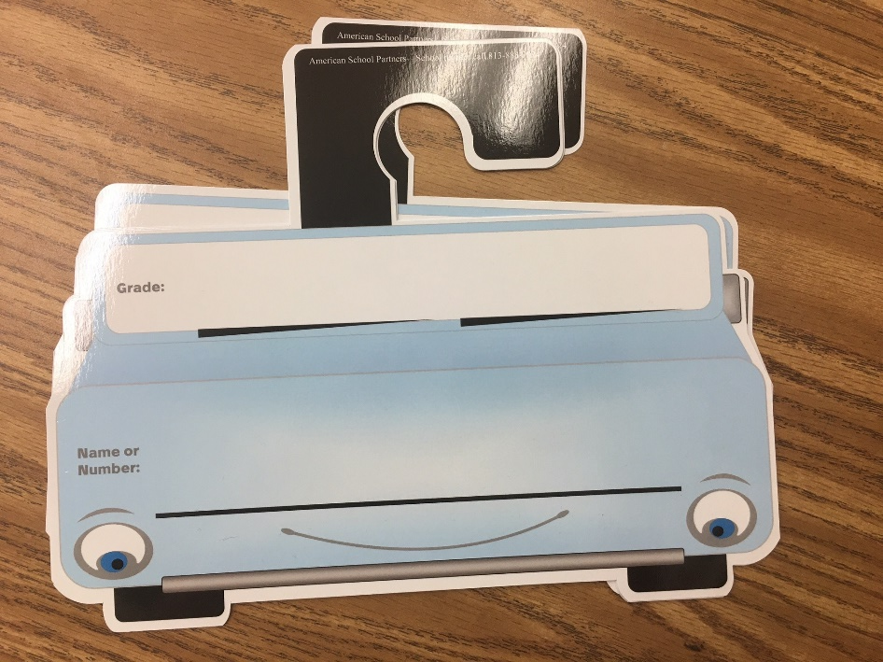
Dismissal
All cars at Parent Pick Up MUST have a sign with their child’s name and teacher's name.

Slide 7
Before & After School Care
HOURS OF OPERATION
& DAILY FEE
​
STORY HOUR
$6.00 per day (all students)
1:50 p.m. to 3:05 p.m.
AFTER SCHOOL CARE
​
1:30 p.m. to 6:00 p.m.
$11.00 per day
(free or reduced lunch rate)
$12.00 per day
(regular student rate)

Slide 8
Attendance
Daily Student Attendance is MANDATORY
Attendance will be taken during the student's first block at 8:20 a.m.
Students will be marked tardy if they are not on time.
Absences will be marked UNEXCUSED (until proper documentation is provided).
If student is absent for three or more consecutive days, parents must provide a doctor’s note.
Parents will have 3 days to submit an excuse note to the teacher.
Medical appointment: If a student is absent from school due to a medical appointment a written statement from a health care provider indicating the date and time of the appointment must be submitted. ALL UNEXCUSED ABSENCES WILL RESULT IN A ZERO (0) BEING ISSUED FOR ANY WORK MISSED ON THE DAY OF THE UNEXCUSED ABSENCE. Please refer to the Parent Handbook for details on excused and unexcused absences.

Slide 9

Attendance
School Board Rule 5200 defines “Excused” school absences as:
✓Student illness.
✓Medical appointment.
✓Death in the family.
✓Observance of a religious holiday or service when it is mandated for all members of a faith that such a holiday or service be observed.
✓School-sponsored event or activity previously approved.
✓Attendance at a center under Department of Children and Families supervision.
✓Other individual student absences beyond the control of the parent or student, as determined and approved by the principal or principal’s designee.

Slide 10
Uniforms
We want to remind everyone that uniforms were made mandatory by the parents at Dr. Gilbert L. Porter Elementary School.
Student uniforms consist of:
Red, white, or navy-blue collared shirt with school logo to be worn Monday-Thursday.
PTA Sponsored School T-shirt can be worn on Friday with jeans.
Navy blue pants, shorts, dresses or skirts Monday-Thursday.
Sweaters must be red, white, or blue.
Shorts and skirts must be of an appropriate length.
Please ensure that your child wears the appropriate uniform colors to school each day. Children may wear sweaters/coats and other type of pants, but must wear the school shirt on cold weather days. When your child is out of uniform, a notice will be sent home. Alternatively, they will be asked to call home to have the appropriate uniform brought or they will be provided a uniform from the clothes donated to the school by the PTA, if any are available. You can also find a complete list of acceptable uniform attire by visiting our PTA office or by calling Ibiley Uniforms.

Slide 11
Free/Reduced Lunch
Breakfast and lunch will be provided FREE for all M-DCPS students this year.
Parents are encouraged to complete an online application at the Department of Food and Nutrition at freeandreducedmealapp.dadeschools.net. to determine eligibility for reduced before and afterschool rates.

Slide 12
Safety
M-DCPS is dedicated to the safety of your child.
Security is required at all schools.
Number of security personnel depends on enrollment and
size of school.
Safety Drills (Fire/Code Red) Done MONTHLY!

Slide 13
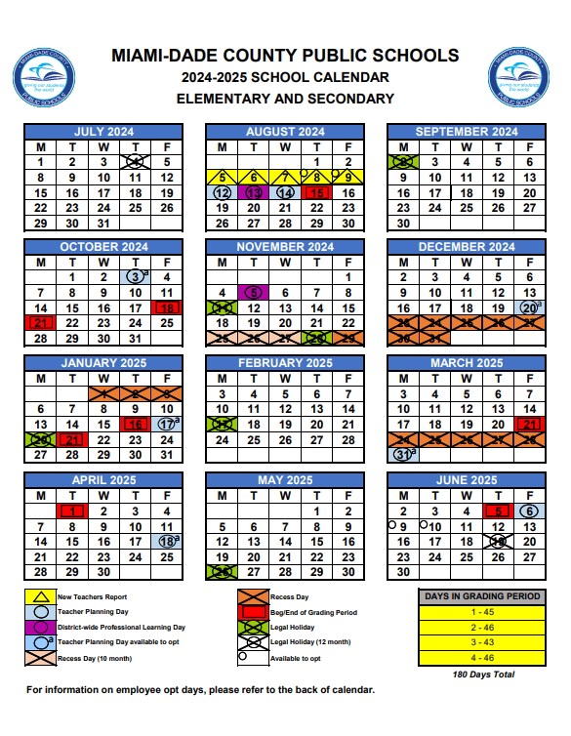
Calendar
Go to the dadeschools.net homepage and click on “Calendar”

Slide 14

Grading
Kindergarten Grades | Numerical Value | Verbal Interpretation | Grade Point Value
E | 100-90% | Excellent | 4
G | 89-80% | Good | 3
S | 79-70% | Satisfactory | 2
M | 69-60% | Minimal Progress | 1
U | 59-0% | Unsatisfactory | 0

Slide 15

Homework
iReady/Imagine Learning
Check the home learning folders daily!
iReady
45 minutes a week in each Reading & Math
Imagine Learning
ESOL LEVEL 1 ONLY
20 minutes 3 times a week

Slide 16
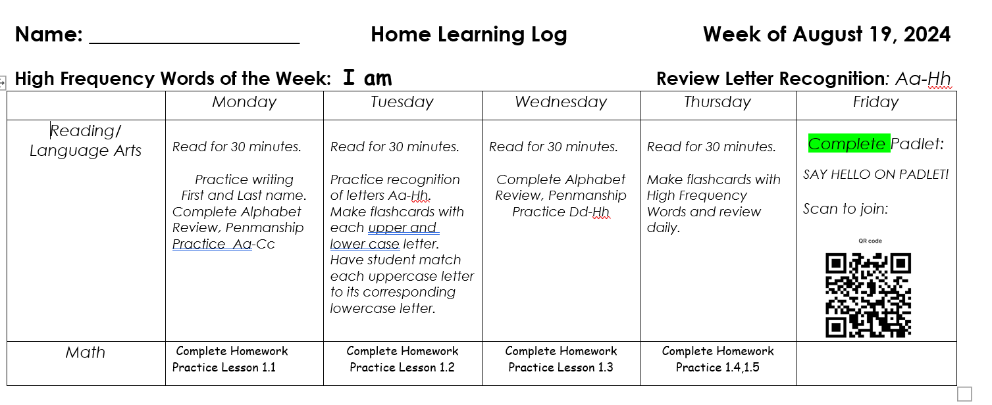
Homework
HFW of the Week
Letter(s) of the Week
Join Padlet

Slide 17

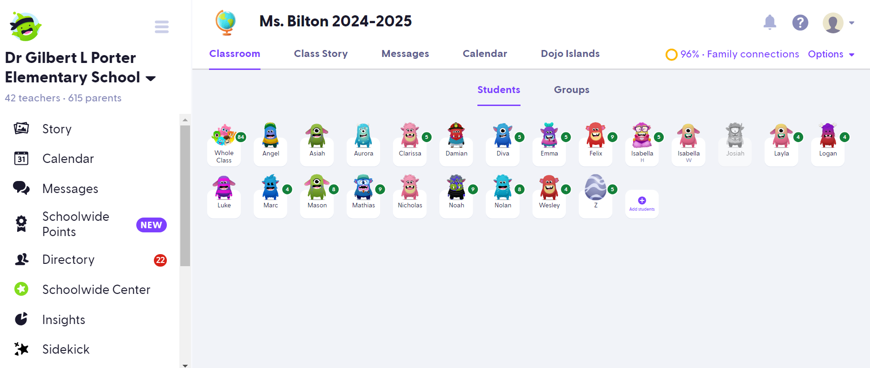
Communication and Class Management

Slide 18
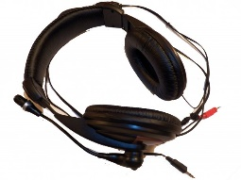
Testing
FAST Testing – (computer based)
Florida Assessment of Student Thinking, or F.A.S.T., refers to the new Coordinated Screening and Progress Monitoring (CSPM) System assessments, which are aligned to the Benchmarks in Excellent Student Thinking (B.E.S.T.) Standards.
FAST assessments will be administered three times per year.
1st FAST Gr. K September 10-15, 2025
Sample test items: https://flfast.org/resources/renaissance-star/renaissance-star
iReady – (computer based)
Assessed 2 times a year beginning in October.
WIRED Headphones are needed for these tests!

Slide 19
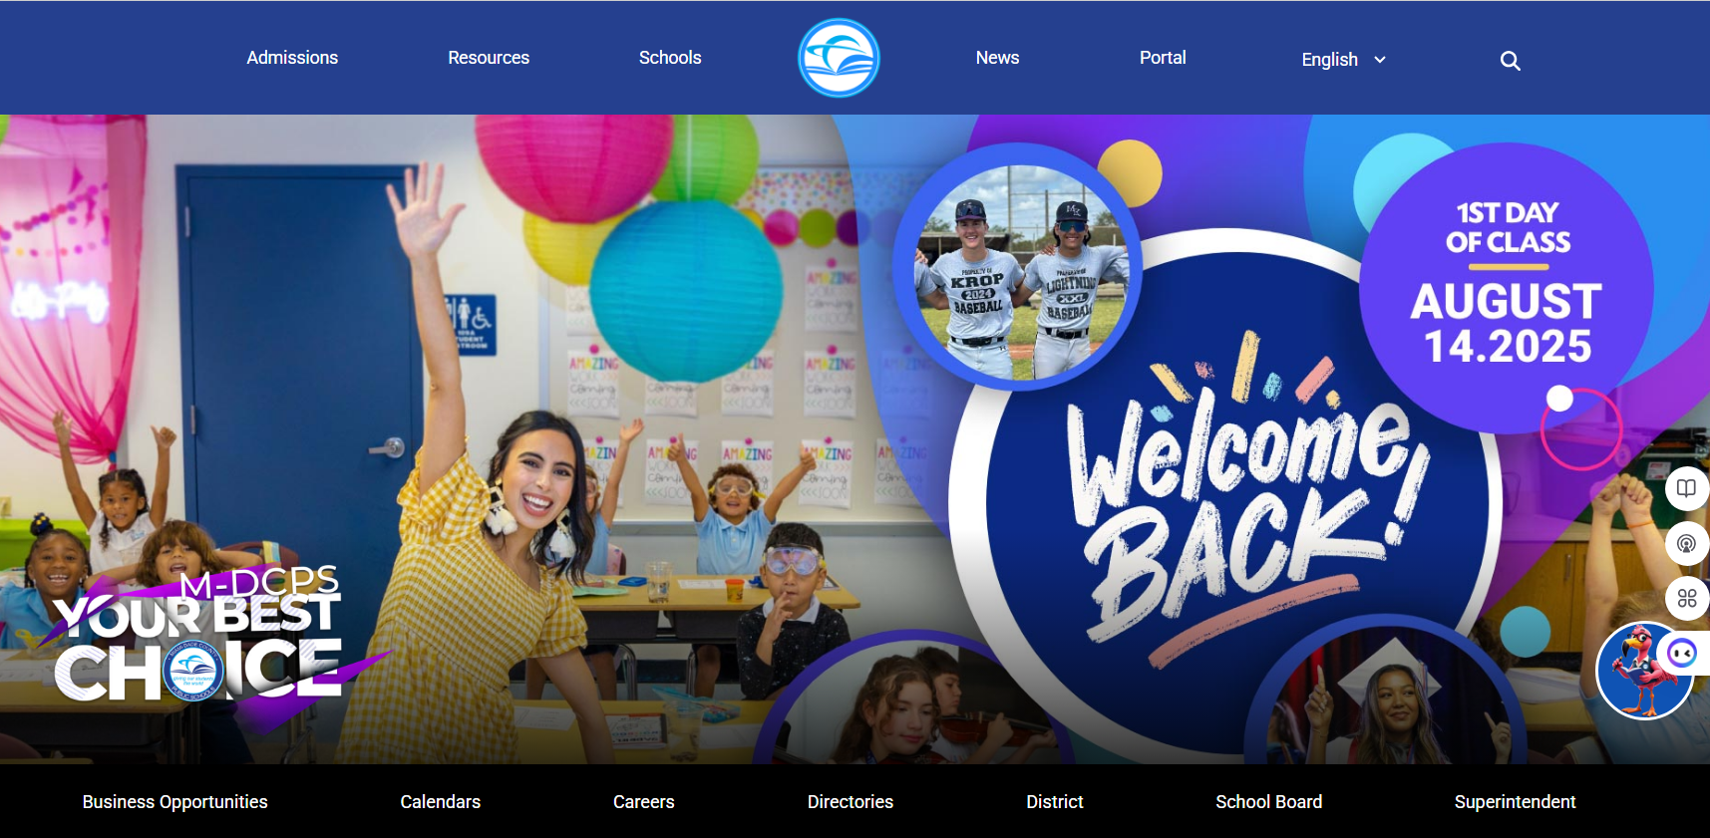
Student/Parent Portal
Access iReady, Imagine Learning, Gradebook, MyON and other resources through the Student Portal.
Report cards will only be available through the Parent Portal.
All field trips will be paid through the OSP system on the Parent Portal.

Slide 20
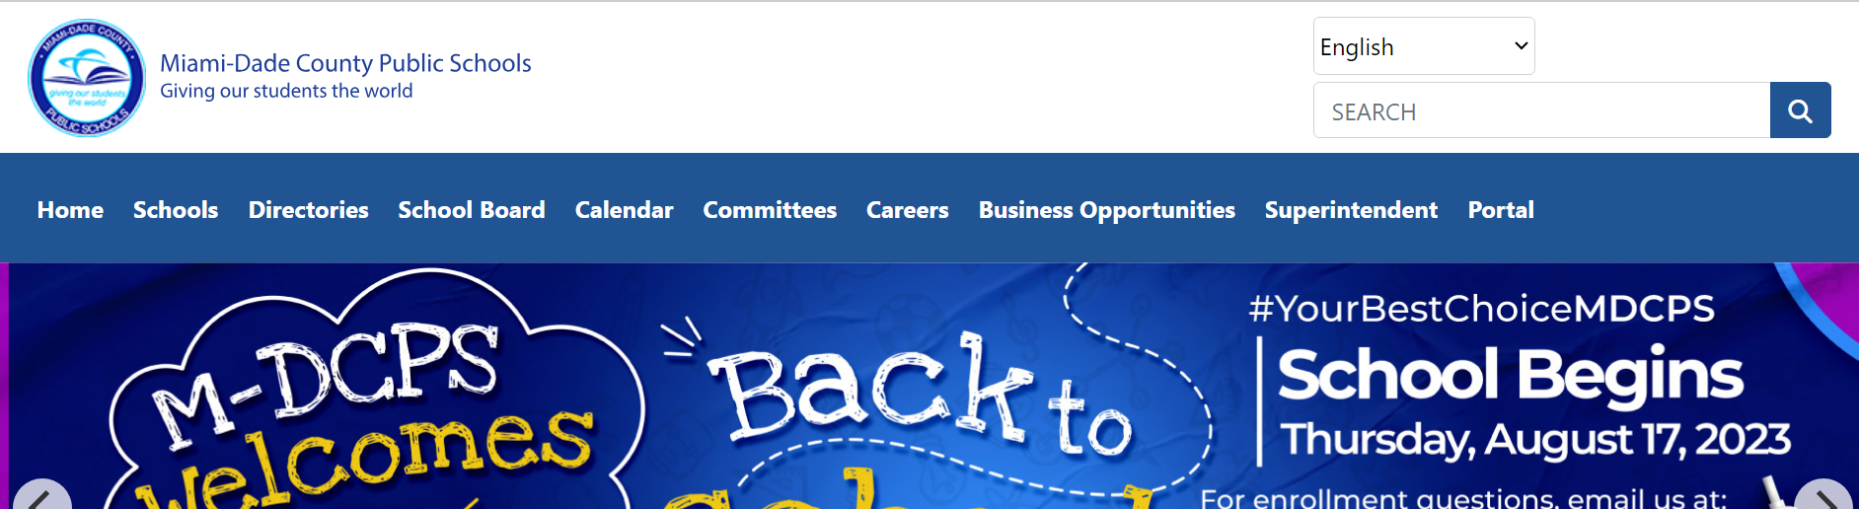
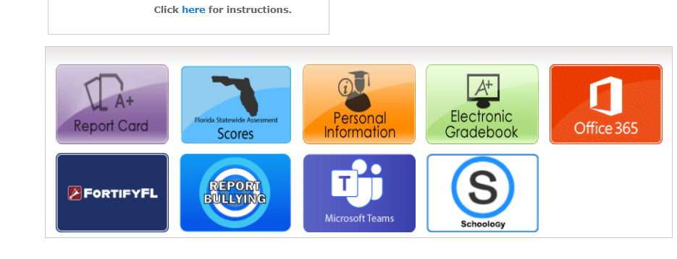
iReady
Step 1: Log into the Student Portal.
Step 2: Go to Schoology.

Slide 21
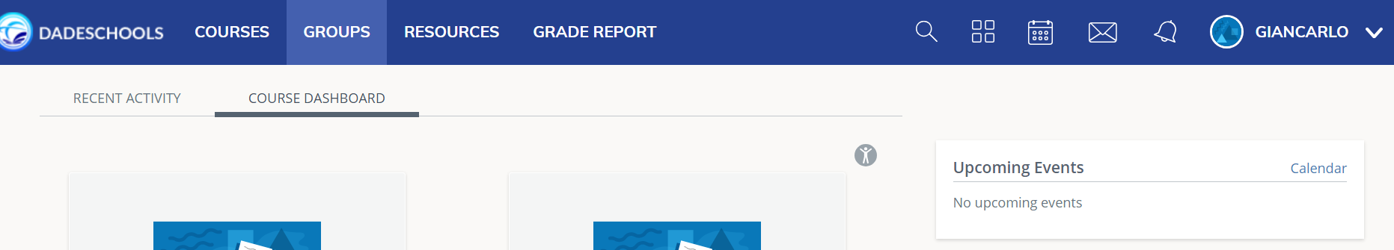
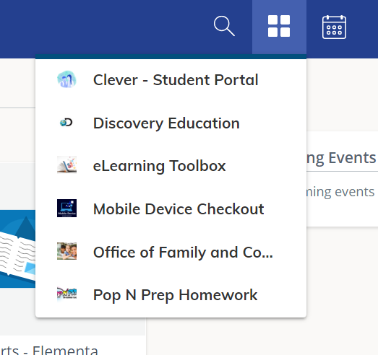
iReady
Step 3: Click on the box split into four boxes at the top.
Step 4: Click on Clever.

Slide 22
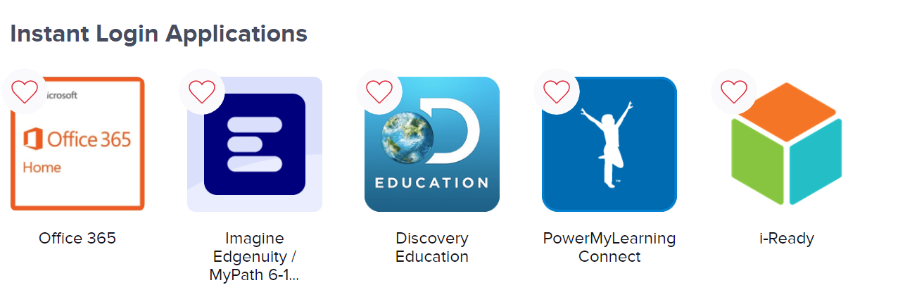
iReady
Step 5: Click ‘Launch App’ and scroll down and find iReady.

Slide 23
Check Grades
Step 1: Log into the Student Portal.
Step 2: Click on Electronic Gradebook.

Slide 24
Class Schedule
SUBJECT | MINUTES
READING | 90 MINUTES
LANGUAGE ARTS | 50 MINUTES
SCIENCE | 30 MINUTES (3X A WEEK)
SOCIAL STUDIES | 30 MINUTES (2X A WEEK)
PHYSICAL EDUCATION | 30 MINUTES
SPANISH (ESOL ONLY) | 30 MINUTES (WEEKLY)
ENGLISH FOREIGN LANGUAGE (EFL)*PARDO ONLY | 60 MINUTES (DAILY)

Slide 25
Volunteers
To begin the process:
Go to the dadeschools.net homepage and click on the “Parents” tab or the “Community” tab.
Or go directly: https://apps.raptortech.com/Apply/MTY6ZW4tVVM=
Volunteer links can be found on the GLP Website!
Note:
All volunteers must be cleared for any event at school.
Volunteers must renew registration each school year.
Volunteers cannot assist during INSTRUCTIONAL time unless, it's a special event or fieldtrips.
Please remember to always bring ID with you when you volunteer.
STORE BOUGHT ITEMS FOR BIRTHDAYS ONLY!!! NO BALLOONS.
Volunteers MUST wear their RED GLP volunteer shirt when at the school or during field trips.

Slide 26



PTA
Volunteers help make our school a success on all levels!
With parent-teacher involvement, amazing things can be accomplished for our children and our school. Our Porter PTA needs volunteers every school day, all year long. The PTA is a wonderful way to be involved with your child’s school. Whether it is a one-time event, volunteering on occasion from home or involving your business, your contribution plays a significant role in enriching our children’s lives. There are many opportunities for you to get involved in your child’s educational experience. Our goal is to help every person find his/her niche. It can be sharing a talent, helping in fund-raising or assisting in the classroom. The possibilities are endless.
We encourage you to join our PTA.

Slide 27
Resources
Dade County Public Schools website to access parent and student portal. Contains resources for parents and students. www.dadeschools.net
The Student Portal includes:
          iReady
          Sumdog
          IXL
          Reflex Math
          MyON
          eBooks for ALL subjects
It is Imperative that your child is able to login and access the Student Portal. I have made sure that the user name and passwords are valid. Please do not reset your child’s password.

Slide 28

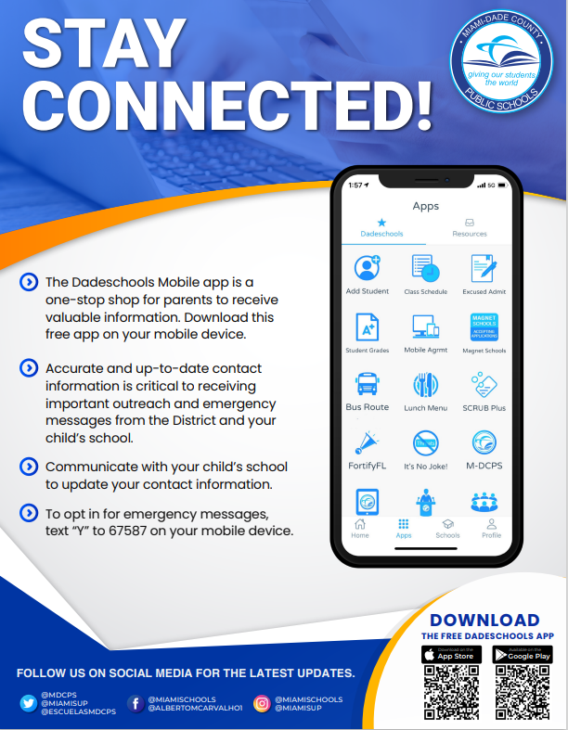
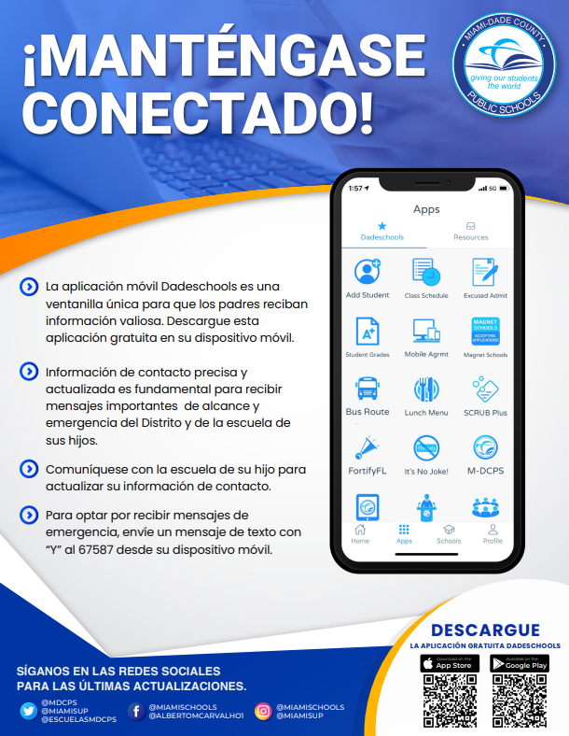
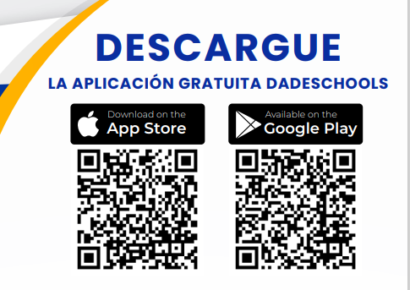
Resources

Slide 29

Questions?
More Information?
www.drglpelementary.org
Or contact us @ Tel:305-382-0792

