Slide 1






Welcome to…
Open House
2025-2026
Dr. Gilbert L. Porter Elementary’s

Slide 2



Open House Welcome Videos
Admin & PTA
Our Superintendent

Slide 3

Stay Connected​
Teacher’s email | marmas5@dadeschools.net ddominguez3@dadeschools.net hflorez@dadeschools.net nlopezm@dadeschools.net
ClassDojo | Ask you homeroom teacher for your individual code
PTA Instagram | @glp_pta
School Website | drglpelementary@dadeschools.org
Portal | dadeschools.net *All parents must use/login to the parent portal. Report cards will ONLY be available through the parent portal. The parent pin is only available in the main office.

Slide 4


Before School
Breakfast (7:45-8:15) and lunch are free.​
All students must go to the PE shelter by 8:15 a.m.​
Students are picked up at the PE shelter by their homeroom teacher at 8:25 a.m. every morning.
After 8:25, they should go straight to the classroom.​

Slide 5
attendance
Students are required to be in class by 8:35 A.M.
At 8:35 A.M. attendance is taken and any student arriving after that time will be marked tardy.
Every absence must be followed by a written excuse given to the homeroom teacher, emailed to 4511attendance@dadeschools.net, or submitted through the parent portal. from home within 3 days of their return to school. (Notes will not be accepted after 3 days of return.) The note must include the following information:
  Student’s name
  Date(s) of absence
  Reason for absence
  Parent’s signature.
After 5 consecutive absences, you need to bring in a doctor’s note.
After 10 absences, the student will be at risk of being retained due to excessive absences.
Make up work will only be accepted from students when their absence is EXCUSED.

Slide 6



uniforms
Uniforms are mandatory​
Red, white, and blue polos with school’s logo
(Mondays-Thursdays)​
Navy blue bottoms (shorts, skirts, skorts)​
NO LEGGINGS​
Jeans and spirit shirts on Fridays ONLY.​
Sweaters/jackets MUST be red, white, or blue.​

Slide 7
dismissal
Students are dismissed at 3:05 p.m. Mondays, Tuesdays, Thursdays, and Fridays. ​
On Wednesdays, they are dismissed at 1:50 p.m.​
Parent pick-up is on the EAST side of the building.​
Each student received a tag with the homeroom teacher’s name and the student’s name. The tag should be displayed on the front windshield of the pick-up car. ​
If there is a change in dismissal procedure, please notify the homeroom teacher in writing, otherwise, the teacher must follow the prearranged dismissal procedure.​
01
03

Slide 8


School safety
All Miami Dade County Public Schools conduct Emergency drills on a regular basis. Your child’s safety is of utmost importance. ​
*Please remind your child to take these drills seriously.​

Slide 9


Devices
House Bill 1105
Student Wireless Communications Device Use
The bill establishes statewide restrictions on student cell phone use and creates a pilot to evaluate full-day prohibitions. The bill:
Prohibits device use by elementary and middle school students during the school day.
Prohibits high school use during instructional time, except as authorized, with teacher-designated storage areas and board-adopted usage zones.
Provides exceptions for medical or educational needs.

Slide 10
Prepared for class
Your child is expected to come prepared for class. ​
This includes ​
-Coming dressed in school uniform ​
-Having all necessary school supplies
-Bringing completed home learning assignments and forms signed
** Students are required to write their home learning each day in their agendas and parents must sign nightly in the space provided. **​

Slide 11
Birthdays
Birthdays will be celebrated by the homeroom teacher in the classroom or at recess.​
The time available for celebrating throughout the day is very limited, therefore, if you would like to send anything to school for your child to share, please follow these guidelines:​
No cupcakes or items with icing allowed​
Only individually wrapped, store-bought treats allowed, but goodie bags are best​
Items must be dropped off at the office​
NO BALLOONS​

Slide 12
Home Learning ​
The purpose of Home Learning is to reinforce concepts already taught in the classroom.
Home learning folder will be used to organize any papers being sent home and any assignments.
Students will be assigned homework each night. Please check your child’s assignments for neatness and completeness, and make sure that all homework has the correct heading.
Any papers requiring signatures will be considered home learning. Please return the following day.
All students are expected to complete the required 45 minutes and pass two lessons for i-Ready Reading and i-Ready Math weekly.

Slide 13

Home Learning ​Continued
Your child is expected to read for 30 minutes each night in addition to the other assigned homework.​
Students will use AR (Accelerated Reader) to test the comprehension of their library books.​
Your child is expected to study for spelling/vocabulary tests and other subject area tests each week.​
Your child will be expected to complete IXL lessons when assigned.​
Your child will be expected to learn their multiplication facts 1-12 with fluency by the end of the school year. Please help them practice daily.​

Slide 14

CLASSROOM MANAGEMENT PLAN​
In order to create and maintain a positive learning environment, students must follow our classroom rules.
Classroom Rules
Listen carefully.
Raise your hand.
Walk in line quietly.
Respect everyone.
Do your work.
Follow directions.
Consequences
Warning
Time out
Teacher/student conference
Parent notification/conference
Excluded from extra-curricular activities
Administration
Rewards
Praise
Happy Notes
Phone calls home
Snacks/Treats/Points
Free time
Special Activities

Slide 15
curriculum
This year third grade students will participate in the Florida Assessment of Student Thinking (FAST) Test in Reading and Math as well as the Third Grade Reading Portfolios.
It is a State-mandated that third-grade students MUST pass the FAST-Reading Test PM3 in order to be promoted.
More information is forthcoming...

Slide 16
FAST: Administration Schedule​
FAST assessments will be administered three times per year. The tentative dates for the three windows during the 2025-26 school year are as follows:​
​
PM1: August – September 2025​
PM2: December 2025 –January 2026​
PM3: April 2026 – May 2026​

Slide 17
FAST Assessment for Grades 3-5​
ELA Reading will be aligned to the Florida’s B.E.S.T. Standards.​
Because all FAST assessments are computer-adaptive, through the Test Delivery System (TDS) secure browser, items may become progressively harder as students successfully respond to items, and easier if students answer more questions incorrectly.​
PM1 and PM2 will be 90 minutes in length for Reading/80 min for Math; PM3 will be 120 minutes in length for Reading/100 for Math.​
Each subject-area test will be administered in one day. It is recommended that each student take only one subject test in a day.​
PM3 will be a summative assessment used for accountability purposes.​

Slide 18
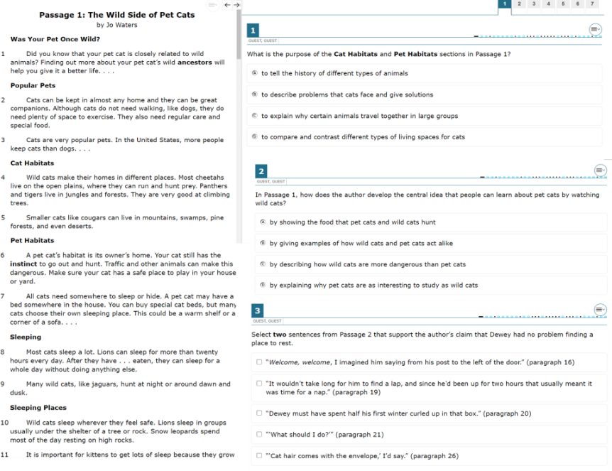

Slide 19
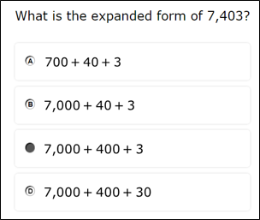
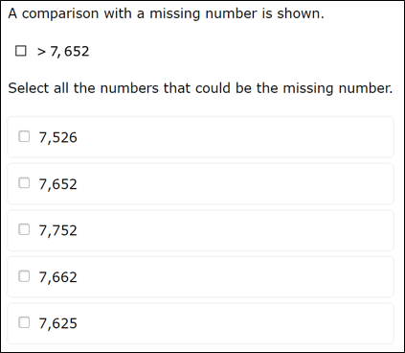

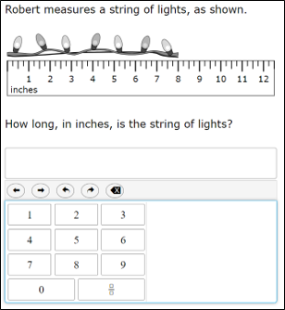
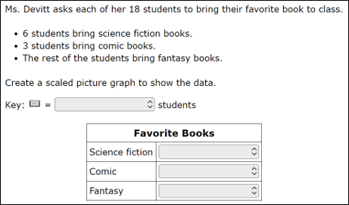
Rewards
Praise
Happy Notes
Phone calls home
Snacks/Treats/Points
Free time
Special Activities

Slide 20
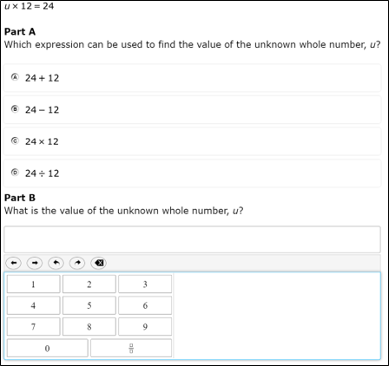
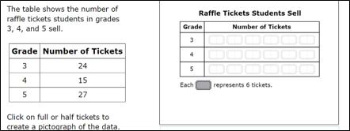
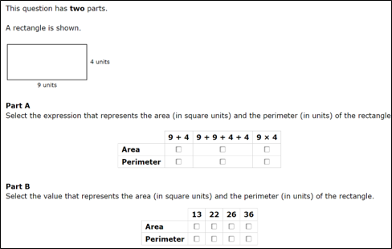
More Sample questions can be found at flfast.org

Slide 21
More information
All money for field trips and events will be accepted through OSP.​
Parents must update their volunteer number every year in order to participate in field trips or school activities. *Please notify your homeroom
teachers once you have confirmation that it is updated.​
Parents must wear the red school spirit t-shirt when participating in a school event/field trip.​
Parent must have their ID when visiting our school.
Security will need it for the Raptor System.​
Please support our P.T.A. by joining. ​
Classes with 100% participation will be rewarded.​

Slide 22

resources
https://mdcpsportal.dadeschools.net​
-Dade County Public Schools website-Contains resources for parents and students ​
https://www.drglpelementary.org ​
-School website. ​
School phone number: ( 305) 382-0792​
School fax: (305) 383-2761​

Slide 23
conferences
The best way to communicate with us…
Class Dojo:​
Please request your class code from your homeroom teacher if necessary.​
E-mails:​
ddominguez3@dadeschools.net​
hflorez@dadeschools.net​
marmas5@dadeschools.net​
nlopezm@dadeschools.net
CRodteach@dadeschools.net​
lvicenty@dadeschools.net ​

Slide 24


Any Questions???
Thanks for coming!

Slide 25












Resource
Page
Use these design resources in your Canva Presentation.
Use these design resources in your Canva Presentation.
Titles: Bungee
Headers: Rubik
Body Copy: Rubik
You can find these fonts online too. Happy designing!

