Slide 1

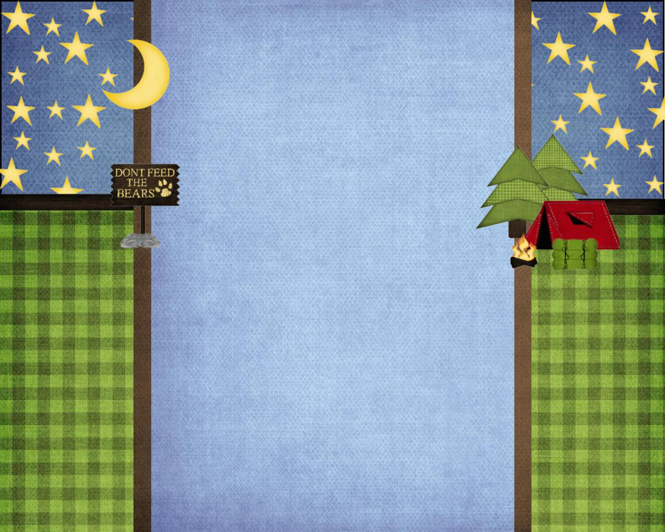

Dr. Gilbert Porter Elementary
Open House
2019-2020
Welcome to
Mrs. Trotz
Class
Dr. Gilbert Porter Elementary Open House 2025-2026
3rd-5th ASD Modified Curriculum

Slide 2


Classroom Community
Our classroom is a community.
These rules help us
get along with each other.
• Be respectful and responsible.
• Be organized and follow directions.
• Arrive on time and prepared.
• Be honest and trustworthy.
Our classroom is a community.
These rules help us
“anchor” positive relationships and promote learning.
• Be respectful and responsible.
• Be organized and follow directions.
• Arrive on time and prepared.
• Be honest and trustworthy.

Slide 3


Vision for my students…
Become independent
Be motivated and excited about learning
Strive for excellence
My goals are to…
Have HIGH EXPECATIONS for all
Meet their educational needs
Bring the best out of every child
Increase Student Achievement
Vision for my students…
-Become independent
-Be motivated and excited about learning
-Strive for excellence
My goals are to…
-Have HIGH EXPECATIONS for all students
-Meet their educational needs
-Bring the best out of every child
-Increase Student Achievement

Slide 4

Daily Schedule/ Behavior
Assignments and Behavior
I will communicate with you if there is behavior problems.
-Please help me with consequences(no iPad, phone, or computer).
I will be sending home a weekly schedule of assignments.
I will communicate through Class Dojo.
-Please help me with consequences(no iPad, phone, or computer).
For positive behavior: there will be positive reinforcers given, such as treasure box, computer time, and bins(Legos, Playdoh, little toys).
I will be sending home a schedule of assignments weekly.

Slide 5

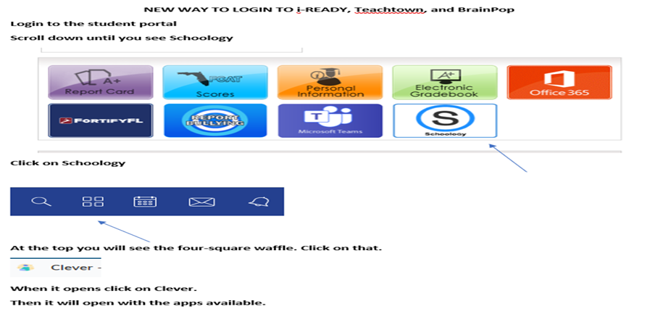
Learning Websites
CURRICULLUM
WE WILL BE UTILIZING i-READY, BRAINPOP JR., IXL, AND READING A-Z
FAA for 3rd-5th MATH & READING
5th SCIENCE
www.dadeschools.net
Login and access i-ready THEY NEED TO DO IT ON THEIR OWN

Slide 6
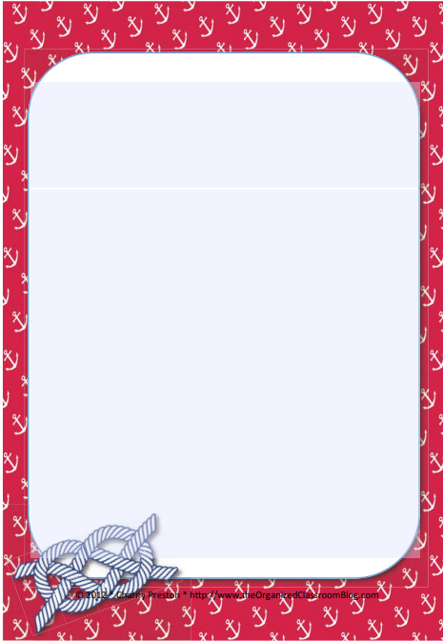
Attendance
Attendance
Side door opens from 7:40-7:55A.M.
School starts at 8:00 A.M.
Late arrivals must pick up tardy slip from the office before coming to class.
Send a note to the teacher for a tardy, absence, or early dismissal.
Side door opens from 8:00-8:20 A.M.
Parents please be patient in the parking lot
School starts at 8:35 A.M.
Dismissal is at 3:05 except on Wednesdays
at 1:50
Late arrivals must pick up a tardy slip from the
office before coming to class.
Send a note to the teacher or email
4511attendance@dadeschools.net for an
absence within 3 days from return date.
Absences more than 5 days
require a dr.’s note.

Slide 7
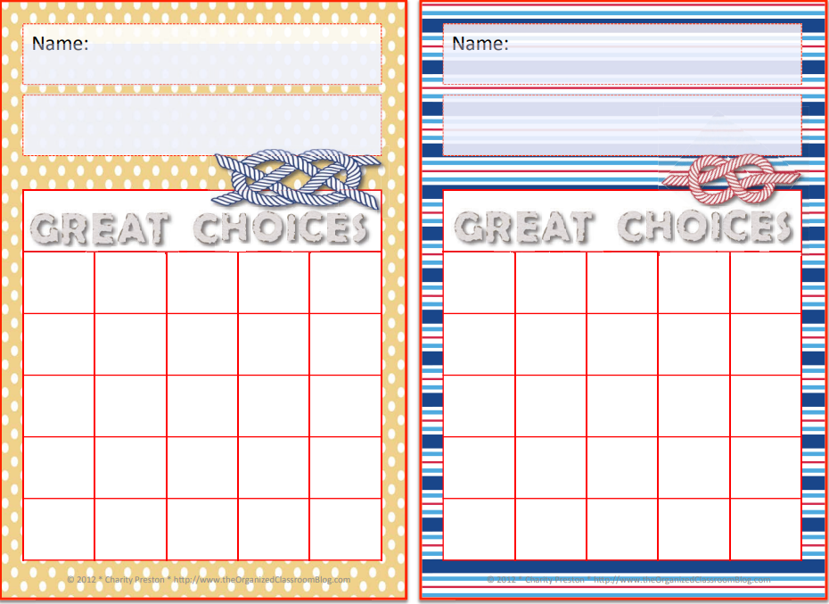
Uniforms
Safety Drills
To Be a Volunteer
You need to re-register every year
You need to have a school shirt to be worn anytime you are going to volunteer (even for a birthday)
We are a mandatory uniform school!
Red, white, or navy polo
style shirt with school
logo.
School t-shirt with logo
May be worn on Fridays
With jeans
Sweater/Jacket must be
  school colors
Navy pants
(no jean shorts)
Bermuda length shorts
RED SCHOOL SPIRIT SHIRT FOR
FIELD TRIPS
Monthly drills will be performed
Safe area
Safety Drills
Monthly drills will be performed
Hard Corner

Slide 8

for all of the Supplies!
Wish List – Copy paper, anti-bacterial, tissue paper (kleenex), baby wipes
Parent Portal
-Use/login to the parent portal
-Report Cards will ONLY be available on portal
-Field Trips can only be paid through portal
-Please have your ID when entering the building
Volunteers
-Must apply every year
-Must wear red school t-shirt to participate in any event (classroom event and/or field trips)
Birthday Celebrations
-ONLY store-bought treats
-NO BALLOONS
-Drop off in the office

Slide 9


For all the supplies
And support!!!

